Slide 1
Final Capstone Project IWA19
Evelyne Kayisinga

Slide 2
Book Connect
A start-up focused on a social media platform for book enthusiasts, has hired a junior JavaScript developer (you) to review and fix the existing JavaScript codebase.
The previous developer did a good job with the HTML and CSS but lacked competency in JavaScript, resulting in critical errors preventing the code from running.
The task was to address these issues, conduct a thorough code audit, and identify areas for improvement in performance, readability, and maintainability.
The client has provided a backlog of prioritized user stories that outline the desired product behaviour.

Slide 3
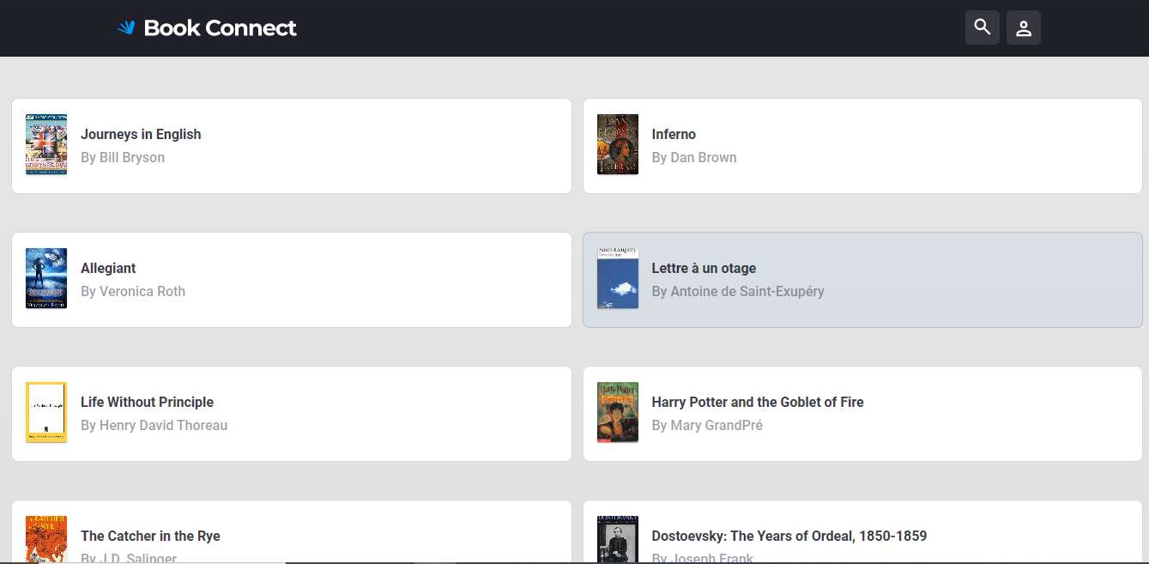
The Book Connect

Slide 4


Code Review Findings
Placement of Critical Error to be Fixed
Just linking tags in HTML

Slide 5

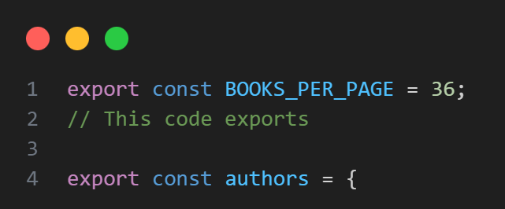
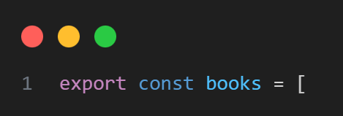
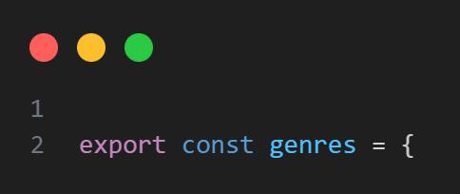
Changes made in Data.js
//Using exports in JavaScript can make the code more complicated, cause conflicts with naming, make modules dependent on each other, use more memory, slow down the performance, and create potential security vulnerabilities.

Slide 6

Common eras in the Script.js
I've fixed the syntax errors, completed the code inside the event listener, and added missing variables and logic.
Adding missing semicolons at the end of statements.
Missing Function Implementations

Slide 7

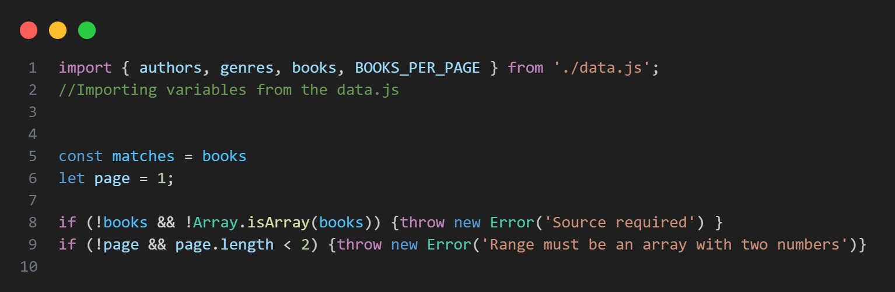
Script.js
//added 'const' to declare 'matches' variable
//added 'const' to declare 'page' variable

Slide 8
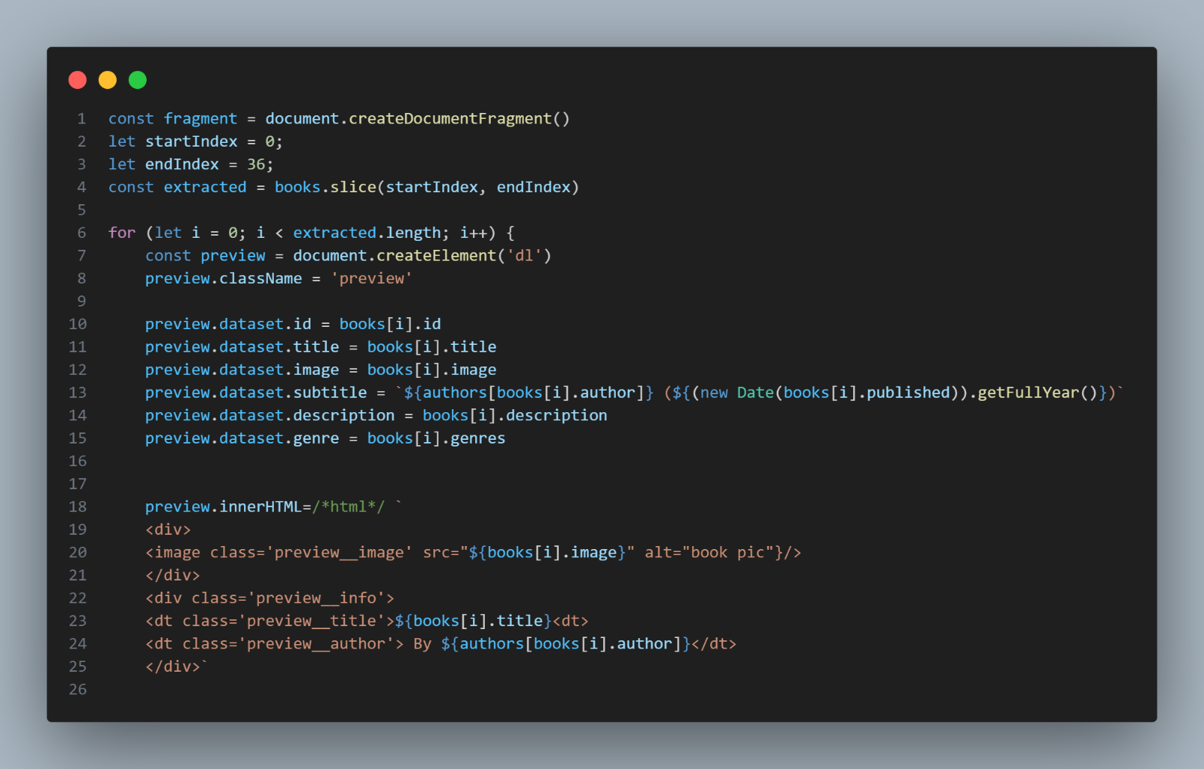

//The code prepares and displays preview elements for a set of books on a webpage.
It creates a temporary container called a document fragment.
Determines the starting and ending positions for the range of books to be displayed.
The code extracts the books within that range from the books array.
it loops through each book in the extracted range.
For each book, performs the following :
Creates a preview element using the provided HTML structure and assigns it to a variable called preview.
It sets the class name of the preview element to "preview".
It assigns various data attributes to the preview element, such as ID, title, image, subtitle, description, and genre. These attributes hold specific information about the book.
It sets the inner HTML of the preview element to include an image element displaying the book's image, as well as the book's title and author.
Finally, the created preview element is added to the document fragment.

Slide 9

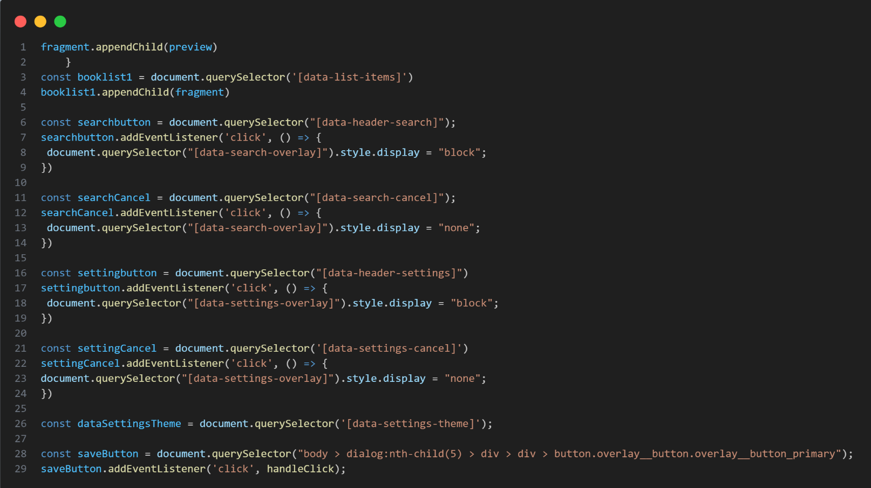
//This code does several things adds a "preview" element to a part of the website that shows a list of books.
Then, it sets up some buttons to perform certain actions when they are clicked.
When you click the search button, a search box appears on the website.
When you click the cancel button in the search box, the search box disappears.
Similarly, settings button.
And when you click the cancel button in the settings menu, the menu disappears.
The code also keeps track of a specific theme setting for the website.
Finally, when you click a specific button, it calls a function to handle that action.

Slide 10
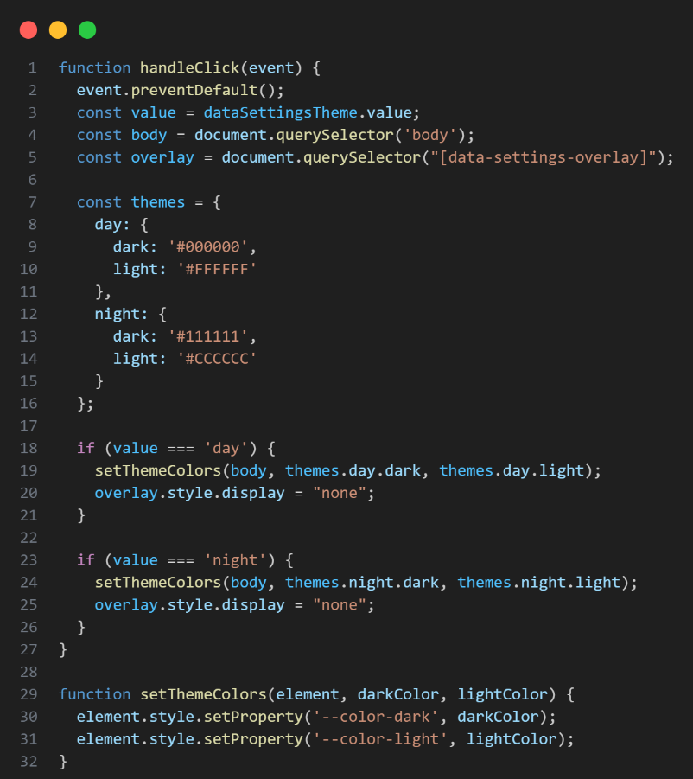
ERROR
//The code gets the value from a specific part of the webpage.
Selects some elements on the webpage.
It defines different sets of colours for two themes: one for the day and one for the night.
If the value is "day," it changes the colours on the webpage to the day theme and hides a settings menu.
If the value is "night," it changes the colours to the night theme and hides the settings menu.
There is also another function that is used to set the colours on the webpage based on the chosen theme.

Slide 11
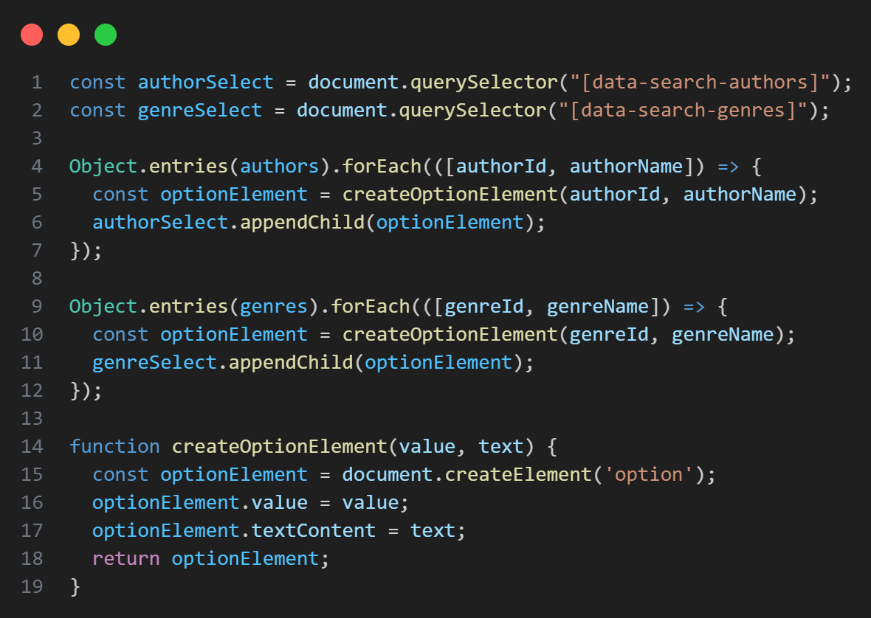
//This code is about creating and filling dropdown menus on a webpage.
With two dropdown menus: one for selecting authors and the other for selecting genres.
With the author's ID and name, it adds options to the author dropdown menu.
The same thing happens for the list of genres. The code creates an option for each genre and adds them to the genre dropdown menu.
The function "createOptionElement" helps in creating these options. It takes a value and text as input and creates an option element with that value and text. It then returns the created option.
Simply the code sets up and fills dropdown menus with options for authors and genres on a webpage.

Slide 12
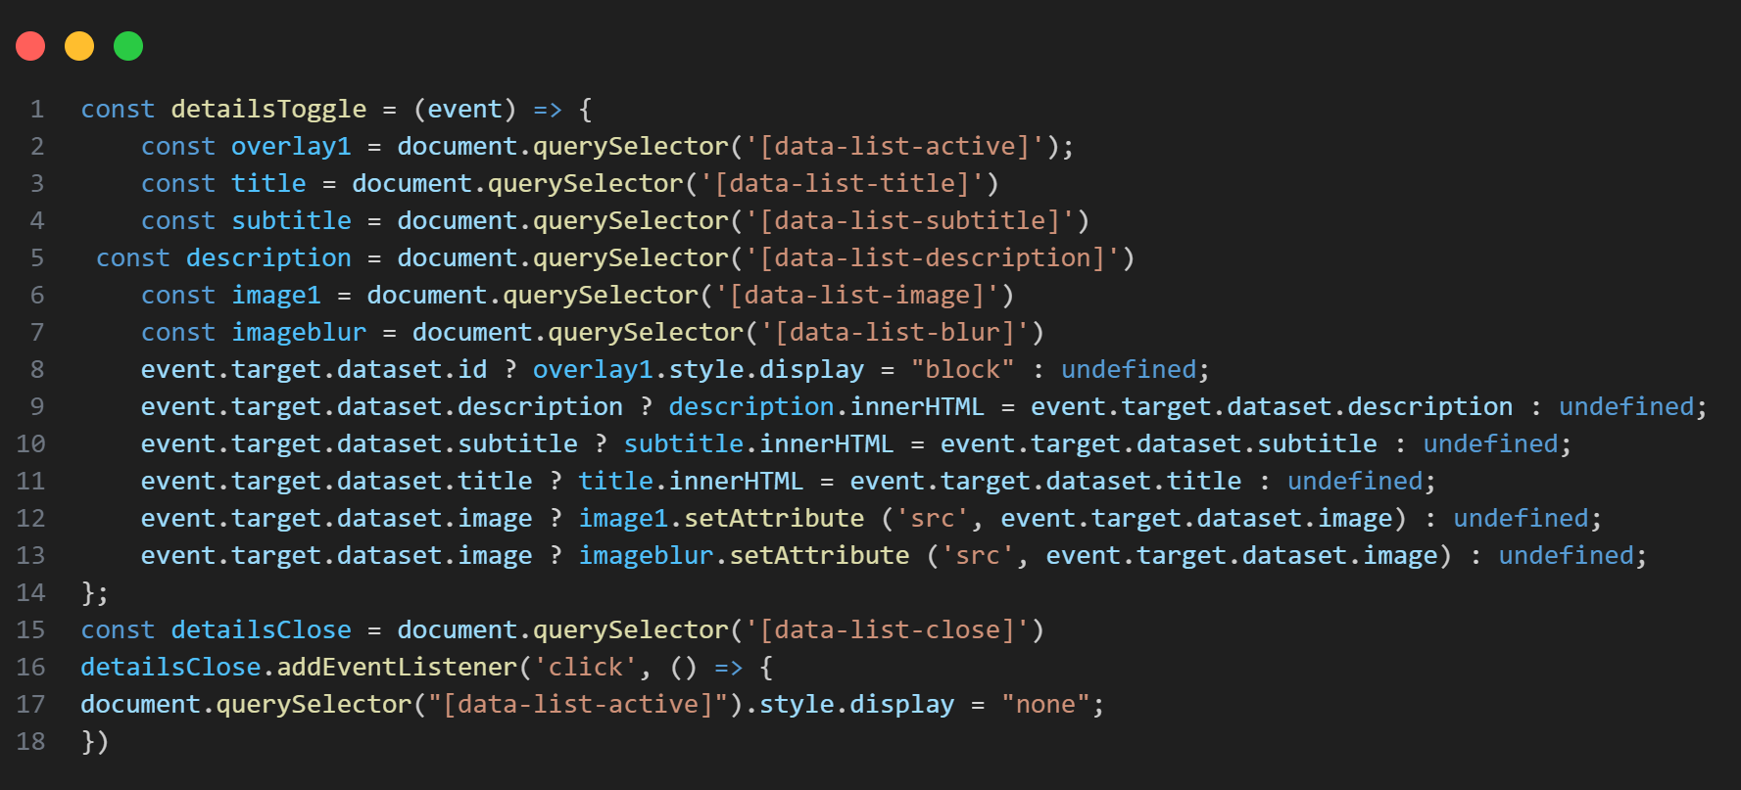
//This code controls a special display that appears on a webpage to show additional details.
It selects different parts of the display, such as the title, subtitle, description, and images.
If the clicked element has a specific attribute, it shows the display on the webpage.
It updates the display with new information based on the attributes of the clicked element. With a close button, and when it is clicked, the display is hidden again.
This code controls a special section that appears on a webpage to show more information when something is clicked.

Slide 13
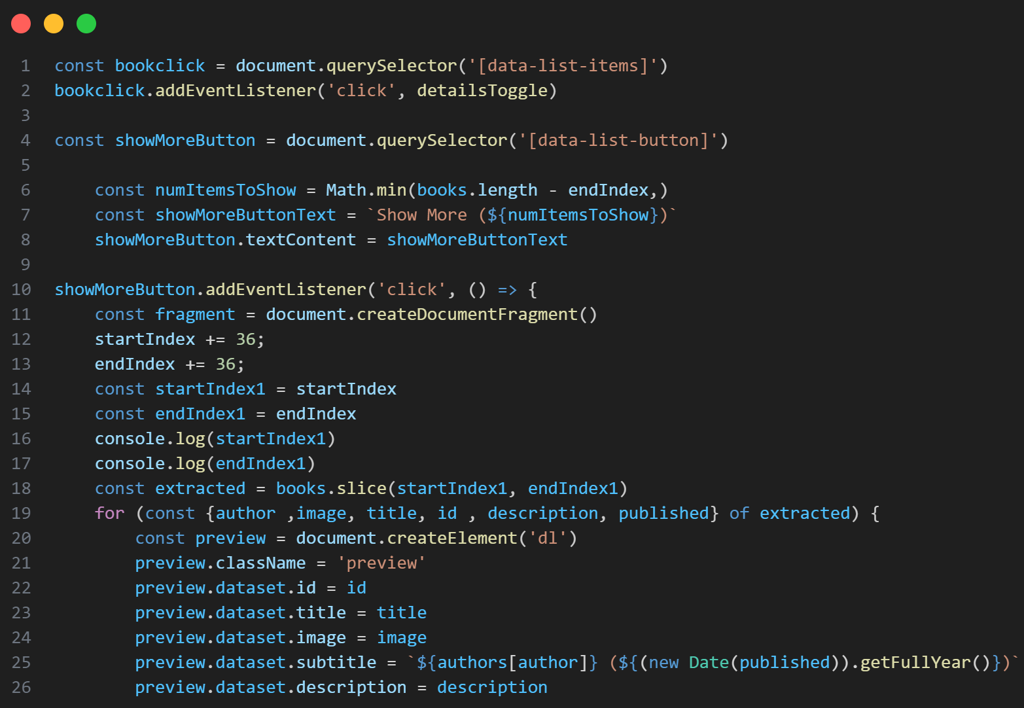
//This code enables the functionality to load and display more book items when the "Show More" button when clicked on a webpage. It updates the button text to indicate how many more items will be shown and dynamically creates preview elements for each additional book.

Slide 14
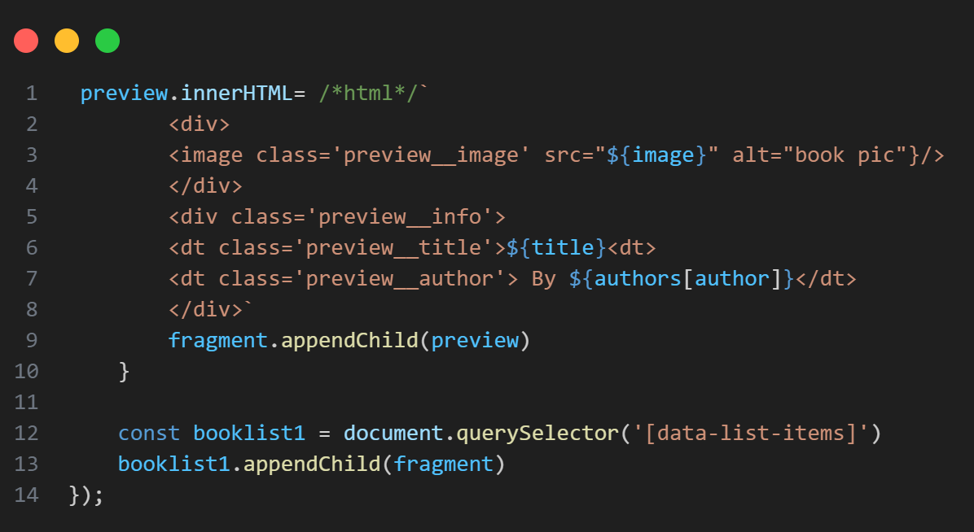
//This code is responsible for displaying book previews on a webpage.
First, it defines the structure of a preview element using HTML code.
Then, it creates a temporary container called a fragment to hold the preview elements.
Loops through each book and does the following for each book:
creates a preview element based on the defined structure, fills the preview element with information like the book's image, title, and author.
The author's name is retrieved from a separate object based on the provided author ID.
The created preview element is added to the fragment.
Finally, it selects the section on the webpage where the book previews should appear and adds the fragment, which contains all the preview elements, to that section.

Slide 15
THANK YOU !
Any questions?

